Slide 1
Linux System Administration
3-User Account Management 用户账号管理

Slide 2
User Accounts用户帐号
Allows multiple people to share resources允许多人共享资源
Each user can have different permissions每个用户可以有不同的权限
Aids in auditing (who did what) 可以辅助监控
Protects system from unauthorized use 保护系统免受非授权用户使用

Slide 3
Authentication vs. Authorization认证与授权
Authentication - Confirming a user is who he or she claims to be (logging in) 认证-确定用户的身份
Authorization - Allow an authenticated user access to specific resources 授权-允许认证用户访问特定资源
Authentication DOES NOT IMPLYAuthorization 认证不代表授权

Slide 4
Authentication Methods 认证方法
One or more of the following factors 受如下因素影响
Ownership factors - something user has 所属因素-用户拥有的东西
Knowledge factors - something user knows知识因素-用户知道的内容
Inherence factors - something user is or does 内在因素-

Slide 5
Authorization Methods 授权方法
Security Policies 安全策略
Access Control Lists (ACL) 访问控制列表
File System Security Settings 文件系统安全设置

Slide 6
User Identification 用户识别
Operating systems refer to users by a unique identifier 操作系统通常采用唯一标识符标识用户
  Linux: user identifier (UID)
  Windows: security identifier (SID)
This allows user to change usernames without affecting the account 因此，用户可以随意改变用户名而不改变账号

Slide 7
User Account Information 用户帐号信息
UID / SID 用户标识符(linux)/安全标识符（windows）
Username 用户名
Password 密码
Home directory 所属主目录
Group(s) 组

Slide 8
Groups组
List of user accounts 用户帐号列表
Aid in assigning access to users 旨在将某资源访问权限分配给多个用户
Each user may be a part of one or many groups 每个用户可以隶属与一个或多个不同组
Unique identifier 唯一标识符
  Linux: group identifier (GID) 组标识符
  Windows: security identifier (SID) 安全标识

Slide 9
Ubuntu Account Types Ubuntu帐号类型
Super User (root) 超级用户（root）
  Complete control of the system 对系统拥有完全控制
  Disabled by default on Ubuntu
  UID = 0; GID = 0
Regular User 普通用户
  User who can log on to the system能够登录系统
System User 系统用户
  Used by programs and services to interact with the system 应用服务用于跟系统交互
sudo passwd root

Slide 10
Ubuntu Accounts Ubuntu帐号
Regular Users: 普通用户
UID: starting at 1000 and up 用户ID>1000
Each account has a private group created with matching GID and is made a member of that group 每个帐号有一个私人组，隶属该组
Each account receives a skeleton directory in /home 每个帐号在/home目录下有个一专属文件夹

Slide 11

/etc/passwd
Red– user name 红色代表用户名
Blue– user id 蓝色代表用户id
Green—group id 绿色代表组id
Shallow green—GECOS, user full name 浅绿代表用户描述，如全名
Orange—home directory橙色代表用户主目录
Yellow—user’s shell program 黄色代表用户shell程序路径
Notes:
Red is username, blue is numeric UserID (uid), lime is numeric GroupID (gid), green is user's full name which is sometimes called 'comment' or GECOS. Orange is for the user's home directory, and yellow is the user's shell program.

Slide 12

/etc/shadow
Red– user name 红色代表用户名
white–encrypted password 白色代表加密密码
Green— 绿代表口令上次更改距1970年1月1日的天数
Tan-minimum password age褐色代表口令更改后不可再更改的天数
Orange—maximum pasword age橙色代表口令更改后必须再更改的天数
Gray-口令失效前警告用户的天数
口令失效后距账号被查封的天数
Notes:
Red is username, white is encrypted password, lime is when password was last changed (measured from 1/1/1970), tan is minimum password age, orange is maximum pasword age, gray is how much warning a user gets of an expiring password, then days after password expires that account is disabled, then an unused field.

Slide 13
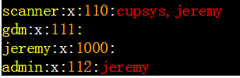
/etc/group
Yellow– Group name 黄色代表组名
white–password 白色代表加密密码,’x’代表未设置密码
orange-group id 橙色代表组ID
Red- members of the group 组里的用户

Slide 14
Commands
groupadd - add a group 添加组
groupdel - remove a group删除组
groupmod - modify group修改组
gpasswd - change group administrator or password 修改组管理员或密码

Slide 15
Commands
useradd - add a system user 添加系统用户
userdel - remove a user 移除用户
usermod - modify a user 修改用户
adduser - add a regular user 添加普通用户
passwd - change password 修改密码

Slide 16
sudo
Short for “super user do“
Allows regular users to run commands as root user 允许普通用户以root身份运行指令
User and rights listed in /etc/sudoers 用户和权限在文件/etc/sudoers
Add users to the “sudo” or “admin” group to give them access 将用户添加到“sudo” 、 “admin” 组里，可以给用户授权
Use ‘visudo’ command to edit file 可以通过visudo 指令进行编辑

Slide 17
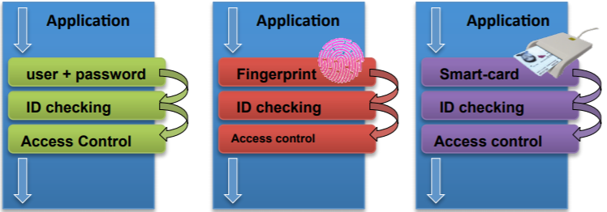
Security 安全
Unification of Authentication Mechanisms: PAM一种统一的认证机制

Slide 18
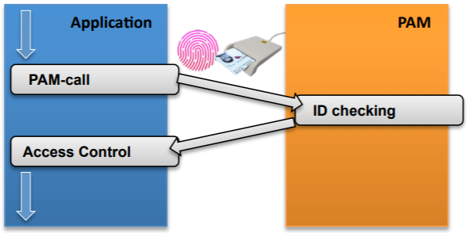
PAM: Pluggable Authentication Module 即插即用认证组件
Common framework for authentication 常见的认证框架
Its library allows developers to abstract from authentication process. 将认证抽象化，供开发人员使用。

Slide 19
Internal PAM structure内部结构
Configure files配置文件
  Each service/application making use of PAM has its own file in /etc/pam.d. 每个使用PAM的应用或服务拥有自己的配置文件位于/etc/pam.d
  File format文件格式:
[module_type] [control_flag] [PAM_module] [arguments].
Notes:
auth: authentication.Example:verify password validity.
• account: verify access permissions. Example: check if a user account has expired.
• password: interface for user password change.
• session: configuration and administration of user sessions.!

Slide 20
Internal PAM structure内部结构
4 Types PAM Modules depending on the authentication process aspect to be dealt with. 4类PAM组件
  auth: authentication. verify password validity
  account: verify access permissions. check if a user account has expired.
  Password: interface for user password change
  Session: configuration and administration of user sessions
Notes:
auth: authentication.Example:verify password validity.
• account: verify access permissions. Example: check if a user account has expired.
• password: interface for user password change.
• session: configuration and administration of user sessions.!

Slide 21
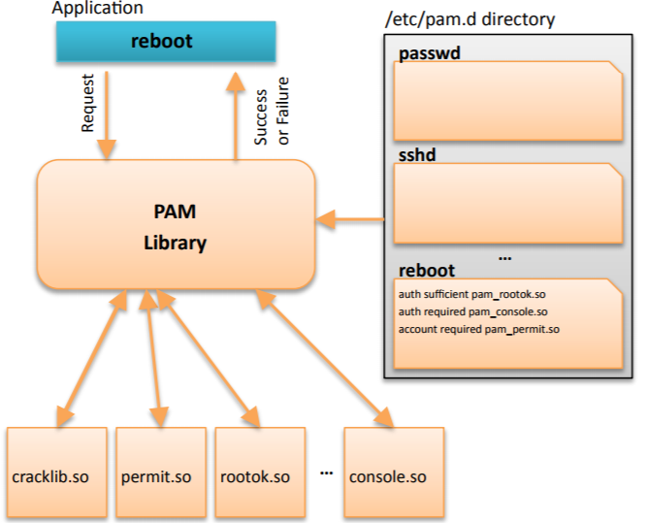
Security

Slide 22
Security
Password protection in the system: Cracklib
  PAM module in charge of verifying password strength: 主要负责检查密码强度
      Objective: to forbid the use of weak passwords (1234) 禁止使用弱密码

Slide 23
Security
Password strength is checked in the following way: 密码强度通常按照如下检测：
  Dictionary comparison (default English). 词典比对，通常是英语词典，但可以链接不同词典
  Comparison with previous password: upper/lower case, number of different characters. 跟之前的密码进行比较，如大小写、不同字符数量
  Length: is it too short? 密码长度
  …..

Slide 24
Security
Required module必须组件: libpam_cracklib (installed) :
Configuration file配置文件: /etc/pam.d/common-passwd:
  Include the following line:
apt-get install libpam_cracklib
password required pam_cracklib.so retry=3 minlen=6.

Slide 25
Best Practices
Each person must have a unique account
Enforce strong passwords & regular changes
Assign minimal rights by default
Log any logins/logouts/sudo usage
Remove unneeded users ASAP
Don't use admin account for daily use

Slide 26
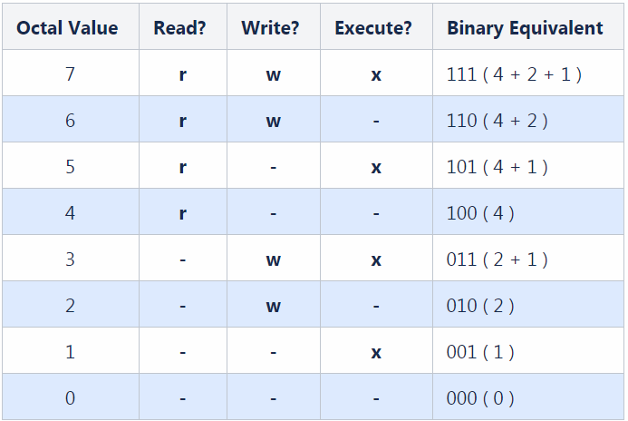

Slide 27
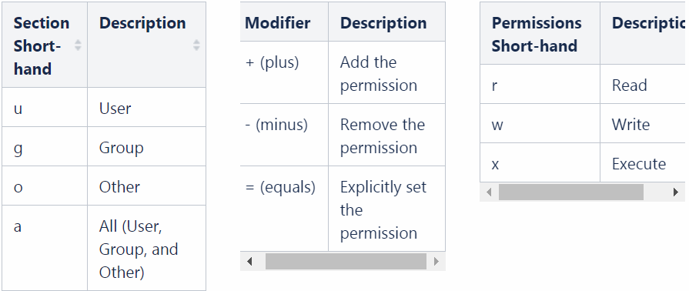
chmod ug+rw /ttt/ttt/x.y

Slide 28
Reference
https://help.ubuntu.com/lts/ubuntu-help/user-accounts.html
https://www.jianshu.com/p/1e3fcfc8e3ef
https://www.digitalocean.com/community/tutorials/how-to-add-and-delete-users-on-an-ubuntu-14-04-vps

Slide 29



The End

